Slide 1

DriverPass System Analysis
Heath Davis
Notes:
[No speaker notes required for this slide.]

Slide 2

System Requirements
Functional Requirements:
Students can register, purchase packages, schedule appointments, and take practice tests online
Staff can assist with phone reservations and drivers can record lesson notes
Owner can enable or disable packages and generate activity reports
System automatically receives DMV updates for current compliance
Nonfunctional Requirements:
Web-based access from any device with internet connection
Cloud-hosted with automatic backups and security management
Page loading under two seconds with encrypted data transmission
Account lockout after multiple failed login attempts
Notes:
Let me start by reviewing what DriverPass needs. The functional requirements describe what the system does. Students will create accounts and purchase one of three training packages directly through the website. They can schedule, modify, or cancel their two-hour driving lessons online. The system includes online practice tests that match the real DMV exam so students can prepare thoroughly. Students can track their progress to see test scores and what they still need to work on. The secretary can help students schedule appointments over the phone for those who prefer personal assistance. Drivers will log in to record notes about how each student performed during their lesson. The owner has control over packages with the ability to enable or disable them without needing a programmer. The system will automatically stay up to date with the DMV by receiving notifications whenever they change rules or test questions. The nonfunctional requirements describe how well the system performs. This is a web-based application that works on any device with an internet browser. The system will respond quickly, loading pages in less than two seconds. It will be built on cloud servers that handle backups and security automatically. Security is built in with encrypted connections to protect sensitive information like credit card numbers and personal data. The system protects against hackers by locking accounts after multiple failed password attempts.

Slide 3
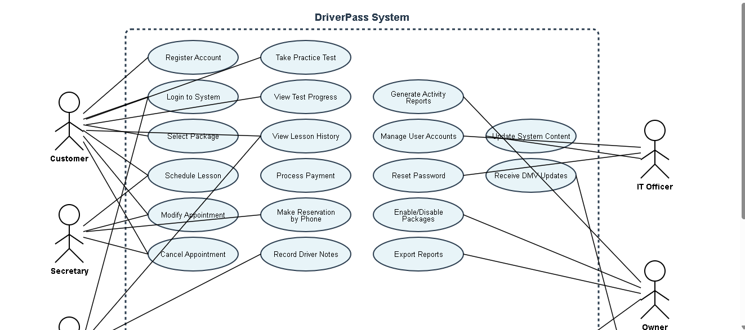
Use Case Diagram
[Insert your use case diagram here.]
Notes:
This diagram shows all the different ways people will interact with the DriverPass system. Think of this as a map of who can do what. On the left side are the different types of people who will use the system. Students are the primary users who will register accounts, login, select training packages, schedule lessons, and take online practice tests. The secretary can help students schedule appointments when they call the office. Drivers use the system to see their schedule and record comments about each student's performance during lessons. The IT officer has special access to manage user accounts and reset passwords. The owner can generate activity reports to see how the business is performing and control which training packages are available for purchase. On the right side is the DMV System, which automatically sends updates to DriverPass whenever test questions or rules change. The oval shapes in the middle represent all the specific tasks or actions people can perform. The lines connecting people to these actions show who is allowed to do what. This ensures students can only access their own information, drivers can only see their assigned lessons, and administrators have the appropriate level of control. Every feature shown here came directly from the requirements gathering conversation.

Slide 4
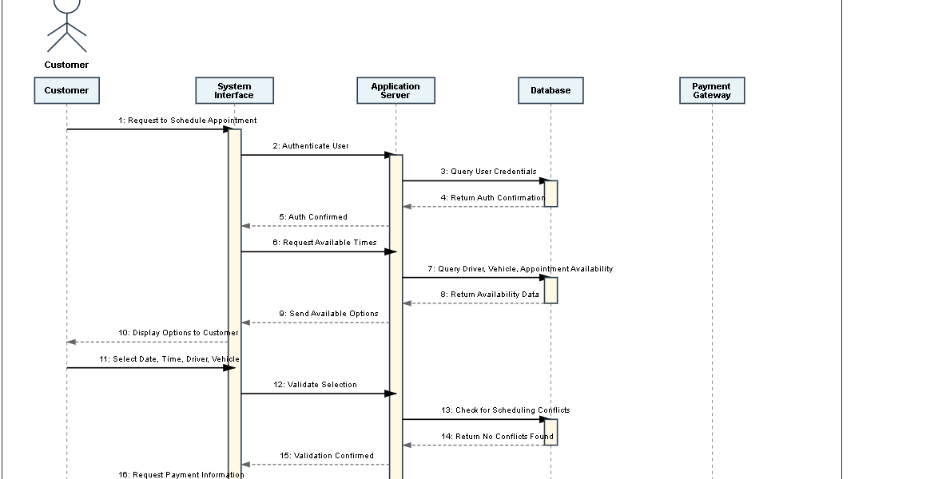
Activity Diagram
[Insert one of your activity diagrams here.]
Notes:
This diagram illustrates what happens when a student wants to schedule a driving lesson appointment. First, the student logs into their account. The system checks this information to verify the user credentials. Once logged in, the student navigates to the scheduling section. The system checks which appointment times are available by looking at driver schedules, car availability, and existing appointments. The student sees available options and picks the date, time, driver, and car they prefer. After the student makes their selection, the system double-checks to confirm there are no conflicts. This ensures two students are not scheduled with the same driver at the same time. If everything looks good, the student enters their payment information. The system securely processes the payment through an encrypted connection to protect credit card details. Once payment is confirmed, the system creates the appointment record, assigning the chosen driver and car to that specific time slot. The student immediately receives a confirmation email with all the appointment details. At the same time, the driver gets a notification about their new assignment. This automated process happens instantly without requiring the secretary to manually coordinate everything. Students get the convenience of booking online whenever it suits them, even outside office hours.

Slide 5
Security
Keeping the Business and Customers Protected
Security measures include:
Role-based access control ensures users only see appropriate information
Password encryption and automatic account lockout after three failed attempts
Encrypted data transmission protects credit card and personal information
Activity logging tracks all system actions for accountability
Cloud servers receive automatic security updates without staff intervention
Notes:
Security is absolutely critical because the system handles sensitive customer information and processes payments. Every person who wants to use the system must log in with a username and password. Passwords are encrypted so they cannot be read even if someone accessed the database. Different user types have different levels of access. Students can only see their own information. Drivers can only access lesson schedules for their assigned appointments. The secretary can help schedule appointments but cannot access payment information. The IT officer can manage user accounts and reset passwords. The owner can view all reports and control business settings. If someone tries to guess a password, the system automatically locks the account after three failed attempts. When information travels between a computer and the servers, it is encrypted so no one can intercept and read it. This is the same technology banks use. When students enter credit card information, it is immediately encrypted and sent to a payment processing company. DriverPass never stores complete credit card numbers. The system keeps a detailed log of every action taken. If an appointment gets cancelled, the system records who cancelled it and when. These logs provide transparency and accountability. Because this system runs on cloud servers, security updates happen automatically. The cloud provider constantly monitors for new security threats and applies protective patches without requiring any action from DriverPass staff.

Slide 6
System Limitations
What the System Can and Cannot Do
Current limitations:
Data modifications require internet connection to prevent duplicate records
System capacity limited to 10 vehicles and corresponding drivers
Structural package changes require developer assistance
Initial release focuses on core functionality with advanced features planned for future updates
Timeline and budget constraints:
Four-month development timeline from requirements to deployment
Budget constraints may limit initial cloud infrastructure scalability
DMV integration success depends on external agency cooperation
Notes:
Every system has limitations, and it is important to be transparent about what this system can and cannot do. First, data can only be modified when online. This was a deliberate design decision to prevent duplicate records if someone tried to make changes offline on multiple devices. Users can view downloaded reports offline, but they cannot modify appointment data or update records without an internet connection. Second, the system is designed to support 10 vehicles and their assigned drivers. This matches the current fleet size mentioned in the initial meeting. If the business grows beyond 10 vehicles, the system can be expanded, but that would require additional development work. Third, while the owner can enable or disable existing packages without a developer, creating entirely new package structures or adding new service types will require developer assistance. The system has flexibility within the existing three-package framework, but major structural changes are not something non-technical users can do themselves. Fourth, this initial release focuses on the core functionality needed to launch the business. Advanced features mentioned for possible future releases are not included in this version. The timeline for this project is approximately four months from requirements collection to final deployment. This timeline was based on the project schedule discussed in the initial planning meeting. Budget constraints may limit how much cloud infrastructure can be provisioned initially, though the system is designed to scale up as the business grows and more resources become available. Finally, the DMV integration depends on the cooperation and technical capabilities of the external DMV system. While we will build the capability to receive and process DMV updates, we cannot control how frequently the DMV sends updates or the format they use. We will work with whatever integration method the DMV provides, whether that is an automated API, email notifications, or another mechanism. These limitations are practical constraints that help set realistic expectations. The system is designed to fully meet the core business needs identified in the requirements gathering phase while leaving room for future expansion as DriverPass grows.

